Slide 1
Cisgenesis and the public opinion
21st June 2011, European Parliament
Niels Mejlgaard, Aarhus University, DK, nm@cfa.au.dk
George Gaskell, Sally Stares, LSE, UK

Slide 2
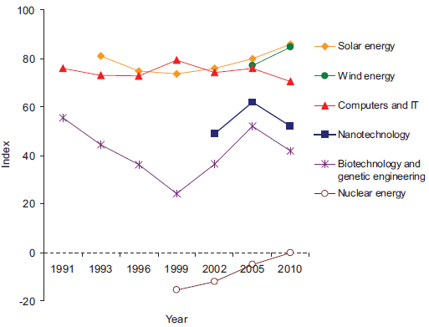
Index of optimism about technologies

Slide 3
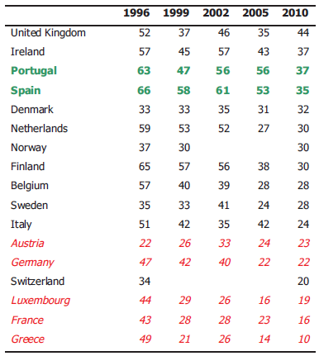
Support for GM food % respondents who agree or totally agree that GM food should be encouraged (DKs excluded)

Slide 4
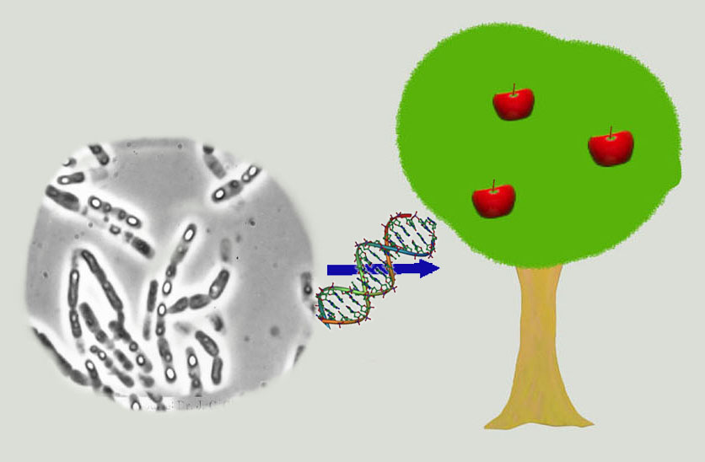
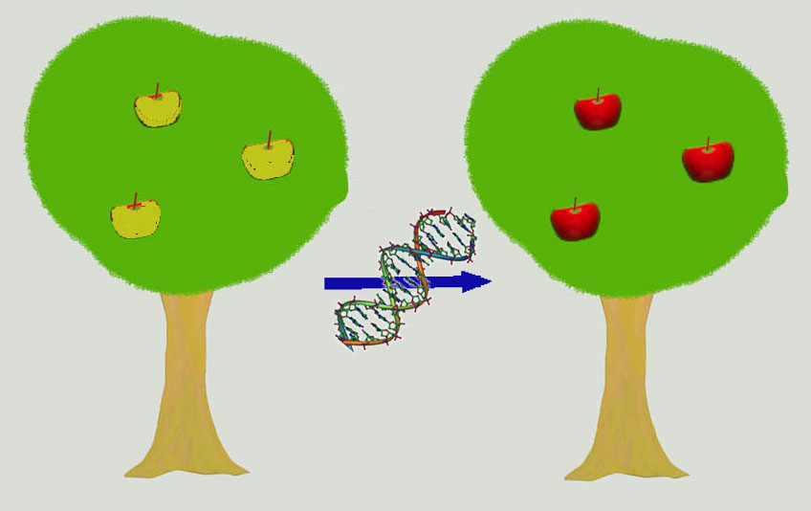

Slide 5
Perceptions of safety, environmental impacts, and naturalness; EU27 (excluding DKs)

Slide 6
6

Slide 7
Conclusion
Since the mid-1990s, optimism about a variety of biotechnological applications has increased along with public trust in regulators and industry. However, GM food has remained controversial and support has declined.
The perceived absence of public benefits and imagined threat to nature’s integrity has been the Achilles’ heel of public disapproval of current GM crops.
Cisgenesis can be seen as a ’technolite’ route to achieving advantages similar to those of current GM crops. Cisgenesis is perceived as less unnatural, less worrying and less harmful to the environemt, and as such more acceptable, by a factor of two.

Slide 8
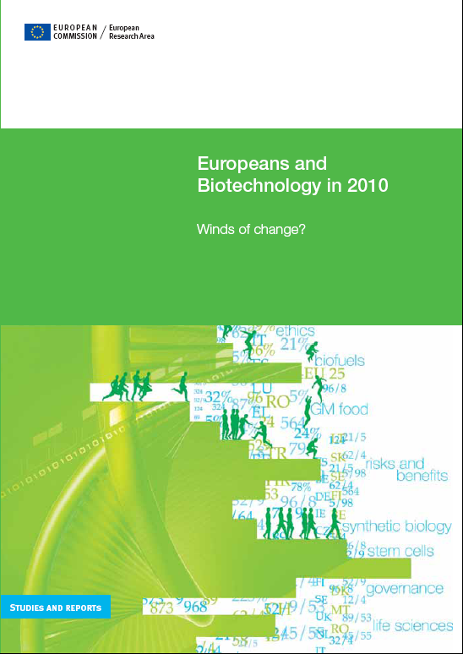
The Eurobarometer 73.1 on the life sciences and biotechnology is part of the research project
Sensitive Technologies and European Public Ethics (STEPE), funded by the Science in Society programme of the EC’s Seventh Framework Programme for research and technological development.
8

